Slide 1
The impact on Air Pollution BBQs vs Traffic
presented by:
Team Laqua
Andrea Angeli Emin Oguz Inci Ali Kadar
Datathon KU Leuven 20/02/2020

Slide 2
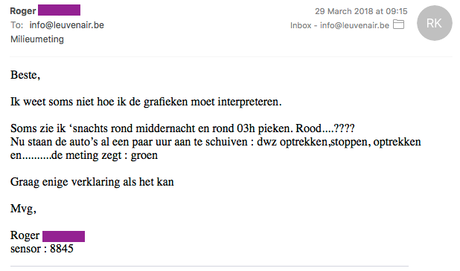
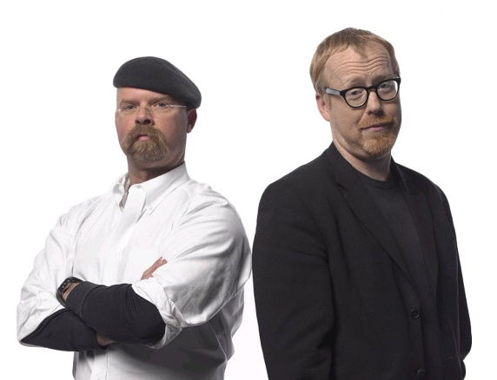

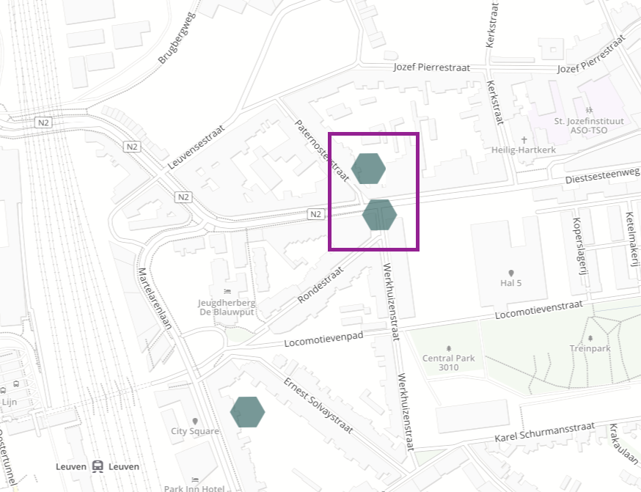
Local effects
Traffic
Fires, BBQ
IS IT SO?

Slide 3
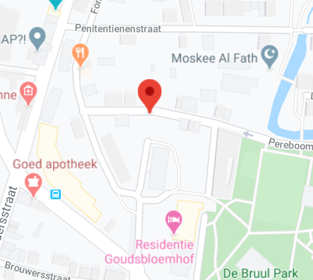
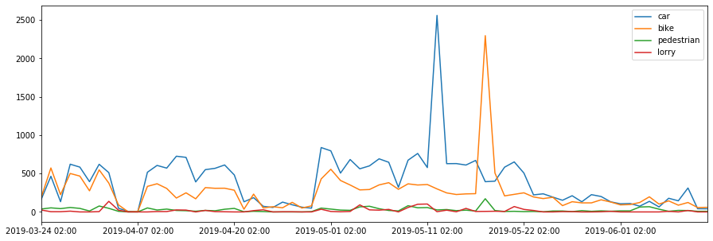
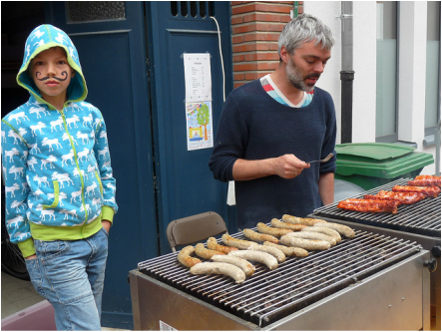
An example
12 may 2019
18 may 2019
Pereboomstraat: 50.884406, 4.693768
Reliable traffic data in Leuven: 5 cameras
Buurtfeest at Pereboomstraat on 18 may 2019
http://www.pereboom.be/buurtfeest-2019.html

Slide 4
Air pollution

